Slide 1
Hidden Markov Models

Slide 2
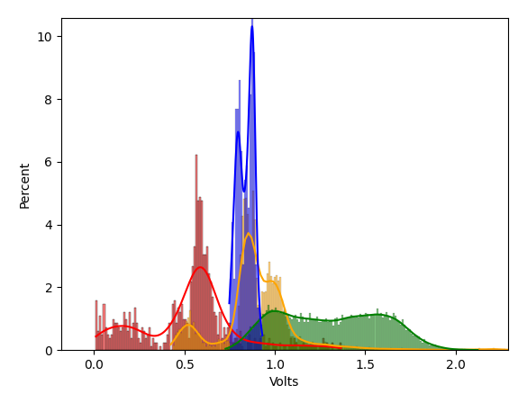
What distribution to use for each state?
At right is a plot of the distributions for each state from a single probe
Red: K
Orange: L
Green: M
Blue: N
Above are listed in the order they occurred. Notice that most are bimodal. Additionally, there is a fair amount of overlap between the distributions.

